Slide 1
Individual Treatment Plan
Putting Together the Pieces of the Puzzle
Gayla Oakley RN, FAACVPR
Boone County Health Center
Albion Nebraska
Presented by
Mark Senn, PhD, FAACVPR

Slide 2
What is an
Individualize Treatment Plan?
A road map of the best ways to provide care for our patients and takes them from the admission assessment through the discharge/follow-up.
This map is to be utilized by ALL those responsible for the patient’s management.
An effective, comprehensive treatment plan can be the difference between a good and a great program.
Notes:
Tab 13 Pulmonary Rehab, Tab 14 Cardiac Rehab
NEW change – now includes the previous tabs for nutritional, education, psychosocial and exercise assessment tools in the care plan
Your plan for the care of the patient while in your program
Journey to arrive at successful outcomes for your patient
Logical pathway for what needs to be done
Provide safe, comprehensive and quality care in a seamless manner
Means to comprehend multifaceted care
All members of the team should know what has been done and what needs to be completed for this patient in order to meet their goals.

Slide 3
Comprehensive components
Assessment
Intervention
Evaluation
Follow-up

Slide 4

Assessment
Intervention
Follow up
Re-Assessment
Notes:
Components of the care plan – analytical and problem solving sequence.
Definitions:
Assessment- what are the problems or the reason the patient is seeking help?
initially determining the needs or problems of the patient in various domains. Tools used for assessments of each of the domains should be completed and labeled to identify which domain it is assessing.
Intervention – what are we going to do to deal with those problems
what steps or treatments will, be and have been performed, based on the assessment in each of the domains for the patient. These interventions should be detailed and progressive, with the documents labeled, showing where the interventions for each of the domains is located, with dates of beginning and ending of an intervention.
Re-evaluation –how did the intervention work
additional or multiple assessments to show progress or need for further intervention, after the initial assessment and intervention. This should have dates when these were performed throughout the plan of care and would be at least at discharge.
Follow-up –keeping on track, what else might be helpful
documentation of additional goals and interventions that are deemed appropriate at or after discharge of the patient. These should also be labeled and have dates associated with them.

Slide 5
Assessment
Starting point
Gather information /behaviors to change determine outcomes to measure
Need all the data before you can make the plan
What is the goal?
Need an assessment for exercise, education, nutrition and psychosocial
Example: (exercise) 6-MWT

Slide 6
Goals
Goals: What is to be accomplish and what is the timeline.
Strategies: What are the approaches to achieve the goals. Collaborative approach to be effective and comprehensive.
Short Term Goals
  Patient goals. They have the right to know, understand and make informed choices but it is the facilitator job to help guide and make the plan.
  Must be measurable and attainable.
  Write goals as if will have patients two weeks.
  Constantly reassess.
Long Term Goals
  Assess
  Beyond rehab

Slide 7
Intervention
Actions necessary to accomplish goals
Evidence based
Reasonable expectations
Specific, measurable and relevant
Individualize, keep in mind contraindications, individual abilities, limitations
Example: (exercise) progressive exercise program in rehab and at home

Slide 8
Re-Assessment
Evaluation of effectiveness
  Obstacles
  How did it work
  May have to revise plan
  May lead to further assessment
Measurable
Example: (exercise) repeat the 6-MWT

Slide 9
Follow-up/Discharge
Was everything accomplished
Where to go from here?
  Keeping on track, what else might be helpful
  How is the ITP reviewed or revised
Pose the next clinical question
Constantly evolving
Example: the goal to be able to walk 30 minutes without stopping was not met…..now what?

Slide 10
Foundation pieces
Exercise
Nutrition
Psychosocial
Education

Slide 11
Additional pieces
Disease management/secondary prevention model.
  Need for improving the chronic disease risk status of its clients, foster healthy behaviors and compliance with these .
Coordinate the multidisciplinary care necessary to achieve the Evidence-based outcomes that result in decreased morbidity and mortality and overall cardiovascular risk reduction.

Slide 12
Mandates and requirements

Slide 13
CMS Regulatory Requirements 410.49
Individualized treatment plan means:
A written plan established, tailored to each individual patient.
Established, reviewed, and signed by a physician and signed every 30 days
that includes;
(i) The individual’s diagnosis.
(ii) The type, amount, frequency, and duration of the items and services under the plan.
(iii) The goals set for the individual under the plan.
.

Slide 14
Statutory Requirements Related to ITP
PL 10-275, effective date 1-1-2010
Outcomes Assessment
  Evaluation of progress as it relates to the individual’s rehabilitation which includes the following:
    Beginning and end evaluations, based on patient-centered outcomes, which must be measured by the physician immediately at the start and end of the program.
    (Cardiac) Objective clinical measures of exercise performance and self-reported measures of exertion and behavior. Programs have the flexibility to determine what measures and tools are used.
    (Pulmonary) Objective clinical measures of effectiveness of the PR program for the individual patient, including exercise performance and self-reported measures of shortness of breath and behavior.

Slide 15
Statutory Requirements
Related to ITP (cont)
Psychosocial Assessment
  A written evaluation provided by CR staff to assess an individual’s mental and emotional functioning related to the individual’s rehabilitation or respiratory condition.
  Pulmonary add; as exercise conditioning, breathing retraining, step and strengthening exercises. An assessment of those aspects of an individual’s family and home situation that affects the individual’s rehabilitation treatment. A psychosocial evaluation of the individual’s response to and rate of progress under the treatment plan.
Physician supervised
  Physician prescribed exercise, including aerobic exercise, prescribed and supervised by a physician that improves or maintains an individual’s pulmonary functional level.
  (Cardiac) risk factor modification, including education, counseling, and behavioral intervention; related to the individual’s care and tailored to the individual’s needs

Slide 16
Statutory Requirements
Related to ITP (cont)
Education or training.
(Pulmonary) Education or training closely and clearly related to the individual’s care and treatment which is tailored to the individual’s needs. Education includes information on respiratory problem management and, if appropriate, brief smoking cessation counseling. Any education or training prescribed must assist in achievement of individual goals towards independence in activities of daily living, adaptation to limitations and improved quality of life.

Slide 17
AACVPR Requirements
Comprehensive, single document
Individualized
Four domains
  Exercise,
  Nutrition,
  Education
  Psychosocial
Each of these domains must reflect the rehabilitation process of
  Assessment
  Intervention
  Reassessment
  Follow-up/discharge
Clearly defined and clearly labeled.

Slide 18
AACVPR ITP Template
Different concepts, some struggle
  Doing a good job but unable to put into a comprehensive plan
  Ah-ha moment
  ITP comprehensive so that anyone can run the program
Template

Slide 20
AACVPR ITP Template
Modifiable
  Adapt to work in your program.

Slide 21
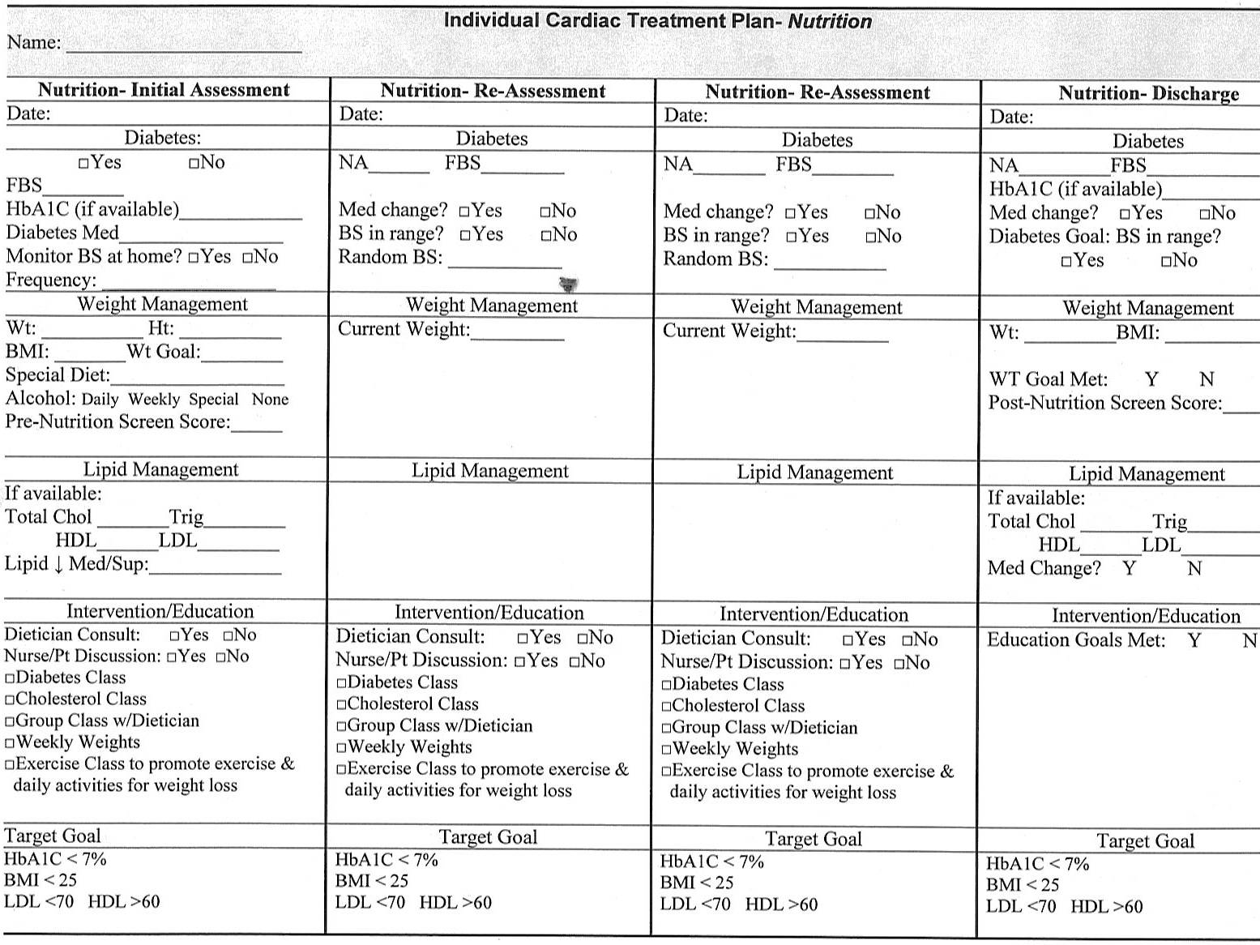

Slide 22
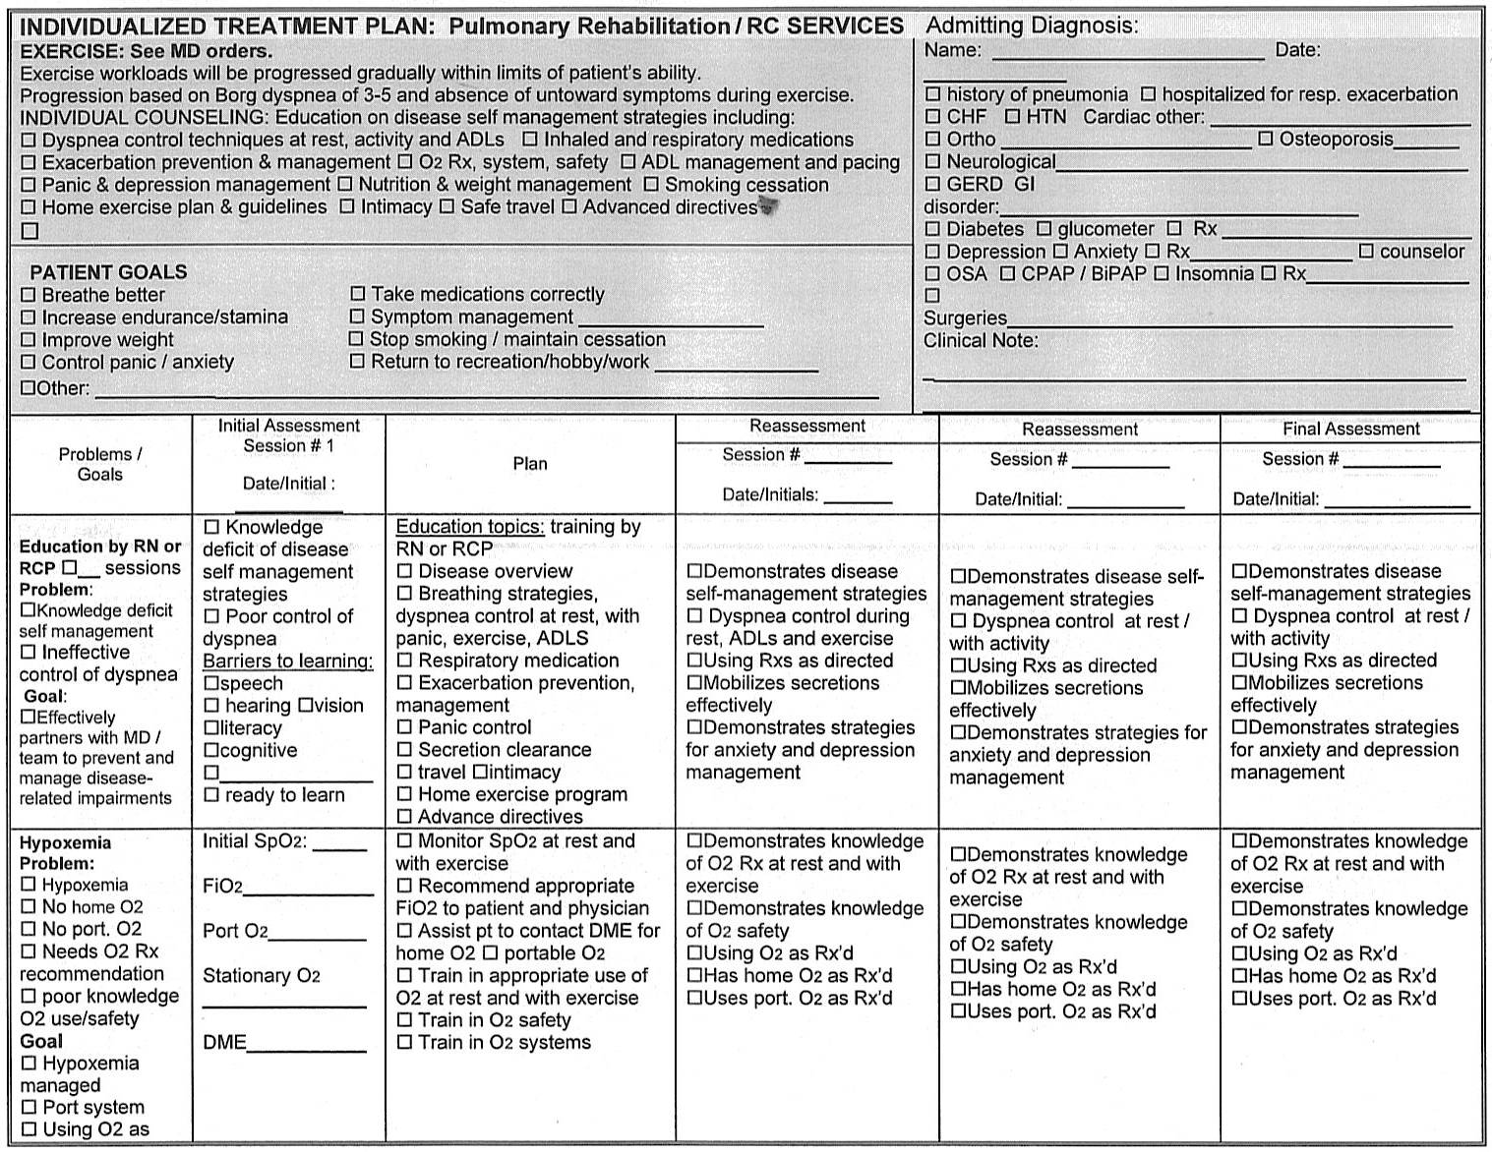

Slide 23
Clearly labeled

Slide 24
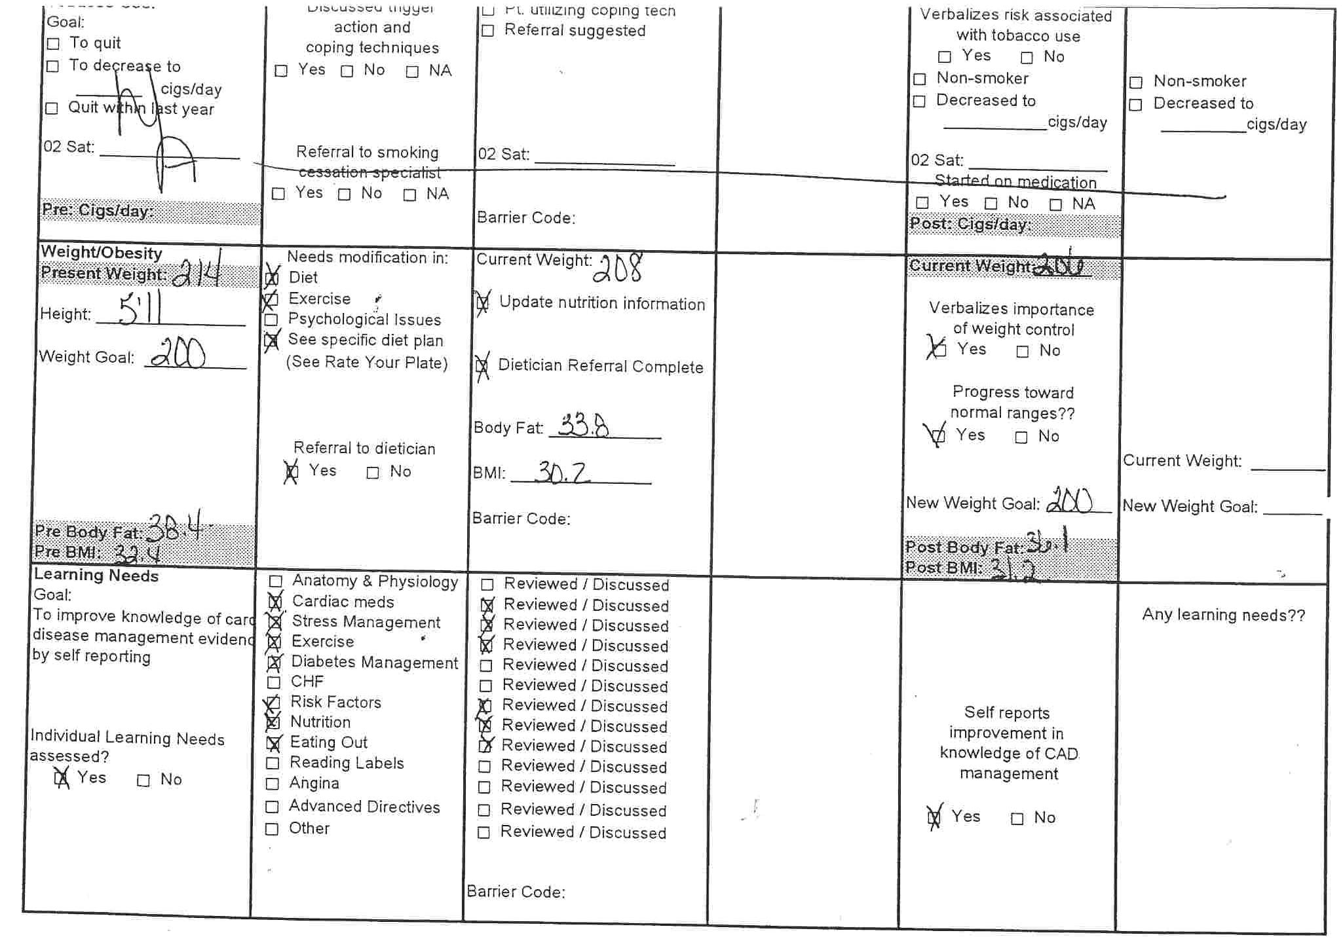
Evaluation
Psychosocial
Intervention Psychosocial
Assessment Psychosocial
Follow-up Psychosocial
Intervention Nutrition
Follow-up Nutrition
Assessment Education
Evaluation Nutrition
Assessment Nutrition
Evaluation Nutrition
Evaluation
Education
Assessment Education
Intervention
Education
Follow-up Education
Notes:
24

Slide 25
AACVPR ITP Template
Member-only benefit
Cardiac or pulmonary

Slide 26
Does your Individual
Treatment Plan????
Does your ITP tell a complete story?
Are you focusing on the data that will be most beneficial to your patients?
Are you managing the chronic disease risk of your patients?
Have you had the ITP AH-HA moment?
Does it allow ALL of the care team to know exactly what has been completed and what still needs to be done?

